Slide 1

Particle Swarm Optimization for Sphere Function: An Analysis
Welcome! We will explore Particle Swarm Optimization (PSO) and its role solving the Sphere function. This presentation will explain the method, settings, performance, and key insights. Let’s dive into this optimization technique that mimics nature!
Presented by
Muhammad Sarmad Chughtai 54915

Slide 2

What is Particle Swarm Optimization (PSO)?
Nature-inspired
PSO mimics birds flocking or fish schooling to find solutions.
Population approach
Particles each represent a candidate solution in the search space.
Guided movement
Particles update velocity and position based on their and swarm's best views.
Key formulas
for velocity update
v_i(new) = w*v_i(old) + c1*r1*(pbest_i - x_i(t)) + c2*r2*(gbest - x_i(t))
for position update
x_i(new) = x_i(old) + v_i(new)

Slide 3

The Sphere Function: A Simple Test Case
Equation
Why choose Sphere?
f(x) = Σ(x_i)^2 for i = 1 to n, where n is dimension.
It's simple and smooth, ideal for initial algorithm testing.
Global minimum is 0 at point x = [0, 0,..., 0].
Easy to understand, perfect for learning optimization basics.

Slide 4

PSO Parameters: Setting it Up Right
Swarm size
Number of particles, usually 20 to 50 for balance.
Inertia weight (w)
Controls particle momentum; typical values between 0.5 and 0.9.
Coefficients (c1, c2)
c1= cognitive trust, c2= social trust, commonly set at 2.
Iterations
Search duration, usually 100 to 500 cycles.
Parameters must be tuned carefully for good results.

Slide 5





PSO Algorithm: Step-by-Step
Initialize
Set random particle positions and velocities.
Evaluate
Calculate fitness value of each particle using Sphere function.
Update pbest & gbest
Update personal best and global best solutions.
Adjust velocity & position
Use formulas to move particles towards bests.
Repeat
Iterate until max iterations or desired accuracy.

Slide 6
Convergence Analysis: How Well Does it Work?
Convergence speed
Trajectory trends
Fitness graph
Measures how fast particles approach the global minimum.
Particles should move smoothly, avoiding unnecessary oscillations.
Fitness value should decrease steadily with iterations.

Slide 7

Impact of Parameters: Tweaking for Performance
Inertia weight (w)
High w boosts exploration, reduces early trapping.
Low w boosts exploitation, fine-tunes search later.
Cognitive vs Social (c1, c2)
High c1 makes particles independent thinkers.
High c2 makes particles follow the swarm closely.
Changing parameters affects convergence and accuracy.

Slide 8
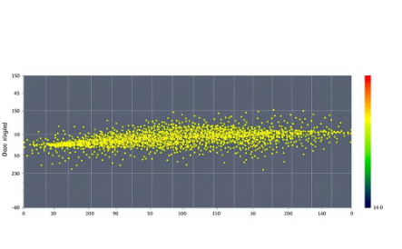


Visualization: Seeing is Believing
Particle Paths
Shows how particles explore and converge in space.
Global Best Progress
Tracks the best solution improving over time.
Fitness Landscape
Reveals search space features and optimization challenges.

Slide 9
Advantages and Disadvantages
Advantages
Disadvantages
Easy to implement and understand.
Can get stuck in local minima.
Few parameters needed to tune.
Parameter tuning critical and problem-dependent.
Works well for continuous problems.

Slide 10

Conclusion: PSO for Sphere – A Good Start
PSO is effective
Sphere function helps
It is a valuable method for optimization problems.
It offers a clear benchmark to test PSO’s performance.
Parameter tuning matters
Keep practicing
Careful setting of parameters improves results significantly.
Consistent effort will help you master optimization techniques.

